Slide 1
P5 Revision Quiz
Space for Reflection
Questions with (H) are higher content only
the other questions are both foundation and higher.

Slide 2
Q1. Satellites.
List as many uses of Satellites as you can.
Define polar and geostationary orbits.
What is the main advantage of each kind of orbit and what kind of satellites is it normally used for?
Explain how satellites stay in orbit.
What is a centripetal force?
(H) How does the period of a satellite relate to its orbit radius.

Slide 3
Q2. Solar system orbits.
Explain how the Moon stays in orbit of the Earth and how the Earth stays in orbit of the Sun.
(H) What is the relationship between a planets period and its position in the solar system?
(H) Why do comets increase in speed as they approach the Sun?
(H) What determines the size of the Gravitational force that an object has?

Slide 4
Q3. Vectors →.
Define the difference between a vector and a scalar.
List two physics quantities that are vectors and two that are scalars.
Calculate the resultant (Total) of the forces below.
a. b.
c. d.
100 N 100 N
180 N 100 N
80 N 280 N
180 N 100 N

Slide 5
Q4. Calculating motion (H).
Use the following formulae to solve the questions.
v =u+at, s=(u+v)t/2 , v²=u²+2as and s=ut+½at²
A car starts at rest and accelerates to 12 m.s⁻¹ in 3 seconds, what is it’s acceleration?
A bike takes 2.5 seconds to go from a speed of 5 m.s⁻¹ to stationary, what distance does it travel while braking?
If a car accelerates at 3 m.s⁻² from a speed of 2 m.s⁻¹ over a distance of 10 meters, what is its final speed?
A ball is dropped from a height of 20m how long does it take to fall?

Slide 6
Q5. Projectiles.
Define what is meant by the term projectile.
Ignoring air resistance what forces act on a projectile?
Describe the path of a projectile launched horizontally.
Describe the motion of a projectile launched horizontally in terms of horizontal and vertical velocities .
(H) A ball is thrown horizontally at 25 m.s⁻¹ at a height of 2 m, how long is the ball in the air? And how far does it travel horizontally?

Slide 7
Q6. Momentum.
Define the term momentum, include how it is calculated, why some objects have more and its units.
(H) How can momentum be used to predict what happens in a collision?
Name 2 safety features in cars that prevent harm and explain how they work in terms of force and momentum.
(H) Explain how force and time relate to the changes in momentum.

Slide 8
Q7. Satellite communication.
Why do satellite use microwaves to transmit a signal instead of radio waves?
Include in your answer the concepts of reflection and refraction.
What is diffraction?
Why does diffraction make radio waves more suitable for transmitting a signal inside the atmosphere?
(H) how does the gap size and wavelength of a wave relate to the amount of diffraction?
(H) What is signal modulation? And what does it do?

Slide 9
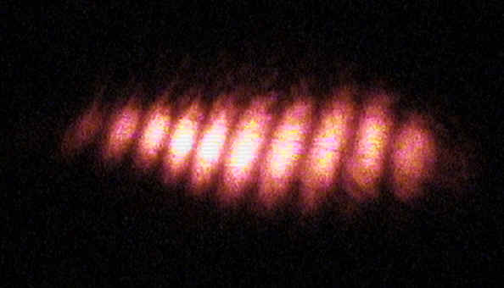
Q8. Nature of waves.
What wave phenomenon does the picture above show?
How are the bight and dark patches formed?
How is this evidence for the nature of light?
(H) Explain the formation of this pattern in terms of path difference and constructive and destructive interference.
(H) How does a pattern created using diffraction form?
What is polarization? And how is it further evidence that light behaves like a wave?

Slide 10
Q9. Refraction
What is refraction and when does it occur?
What happens to a wave when it is refracted going into an optically more dense medium?
Why does refraction through a prism cause white light to split into a full spectrum (rainbow)?
Draw a diagram to explain why fish appear closer to the surface of the water than they really are.
(H) use n = sin θi / sin θr to find the refractive index for light hitting water at an angle of 30.0⁰ and refracting in the water at 22.6⁰.
(H) What will the speed of light be in the water? (use n = v_{c}/v_{w}).

Slide 11
Q10. TIR
What does TIR stand for and what happens?
What are the conditions required for TIR to occur?
(H) Define the term critical angle.
(H) What is the critical angle of light in perspex block with a refractive index of 1.6? n = sin θi / sin θr

Slide 12
Q11. Lenses
Draw a diagram and explain what a convex lens does to parallel beams of light.
What are 3 common uses for convex lenses? Why are they used for these jobs?
How does a camera focus an image onto the film?
(H) use a diagram to show where the image of a 1.5 cm high object 5 cm from a convex lens will form if the lens has a focal length of 2 cm.
(H) Describe the nature of the image formed from the question above using 3 ideas.
(H) Define the terms real and virtual.
(H) What is the magnification in this situation? M=H_{i}/H_{o}

